Slide 1
EPP2
Tutorial 7

Slide 2
Part1
Secure Networking

Slide 3
1. Serializing
When Vincent’s Raspberry Pi communicates with his Arduino, we populate a variable of type TPacket, then serialize the TPacket data structure simply by copying over the entire structure into an array of char (i.e. an array of bytes):
TPacket packet;
… Code to populate packet’s fields …
char buffer[MAX_PACKET_LEN];
memcpy(buffer, &packet, sizeof(TPacket));

Slide 4
1. Serializing
However when Vincent communicates with another host over the Internet through vincent-server.cpp and vincent-client.cpp, he populates an array instead of a structure, using a format similar to the following, where each element is of type char.
0 | 1 | 2 | 3 | 4 | 5 | 6 | 7 | 8 | 9
3 | Command | Param 0 (4 bytes) |  |  |  | Param 1 (4 bytes)
Why do you think this was done in place of serializing a data structure?
What are the relative advantages and disadvantages of each approach?

Slide 5
1. Serializing
Most hosts today are 64-bit systems, as opposed to the 32-bit Raspberry Pi, and there are also a far wider range of compiler configurations on these hosts.
For that reason we are unable to reliably pad any data structures to ensure that the Pi correctly interprets what the client sends to it.
However an array of int32_t will be received as exactly that; an array of int32_t elements.

Slide 6
1. Serializing
This layout guarantees that the Pi on Vincent receives exactly what the client intended to send it, SUBJECT TO BOTH SIDES USING THE SAME ENDIANNESS.
To ensure correct endianness it is a good idea to use htonl to convert to “network byte order” and ntohl to convert back to host byte order:

Slide 7
1. Serializing
On the client side:
buffer[0] = htonl(3);
buffer[1] = htonl(command);
buffer[2] = htonl(param0);
On Vincent’s side:
packetType = nhohl(buffer[0]);
etc.

Slide 8
1. Serializing
Advantage of the data structure approach is that it is easier to re-assemble the data, assuming that you match endianness and padding.
Advantage of the array approach is that it works reliably regardless of machine word size.
Given your answer above, suggest how we could have implemented data structure serialization on vincent-client.cpp and vincent-server.cpp.

Slide 9
1. Serializing
We need to use standard byte-ordering functions
The htonl() function converts the unsigned integer hostlong from host byte order to network byte order.
The htons() function converts the unsigned short integer hostshort from host byte order to network byte order.
The ntohl() function converts the unsigned integer netlong from network byte order to host byte order.
The ntohs() function converts the unsigned short integer netshort from network byte order to host byte order.
uint32_t htonl(uint32_t hostlong);
uint16_t htons(uint16_t hostshort);
uint32_t ntohl(uint32_t netlong);
uint16_t ntohs(uint16_t netshort);

Slide 10
1. Serializing
On the sending side:
typedef struct t
{
int x;
char c;
int y;
} TData;
TData data;
data.x=1;
data.y=2;
data.c=’A’;
char buffer[128];
int ndx = 0;
buffer[128]
ndx

Slide 11
1. Serializing
int32_t tmp = htonl(data.x);
memcpy(&buffer[ndx], &tmp, sizeof(tmp));
ndx += sizeof(tmp);
memcpy(&buffer[ndx], &data.c, sizeof(data.c));
ndx += sizeof(data.c);
data.x
c
data.y
tmp = htonl(data.y);
memcpy(&buffer[ndx], &tmp, sizeof(tmp));
ndx += sizeof(tmp);
sendData(buffer, ndx);
ndx
ndx
ndx

Slide 12
1. Serializing
On the receiving side:
// Received data is in inbuffer
TData data;
int ndx=0;
int32_t tmp;
memcpy(&tmp, inbuffer[ndx], sizeof(tmp));
data.x = ntohl(tmp);
ndx += sizeof(tmp);
data.c = inbuffer[ndx];
ndx+=sizeof(data.c);
memcpy(&tmp, inbuffer[ndx], sizeof(tmp));
data.y = ntohl(tmp);
inbuffer
data.x
c
data.y

Slide 13
1. Serializing
As you can see the only way to reliably serialize a data structure is to go field by field, convert it to the correct byte order, and then copy over a KNOWN number of bytes.
This means that serializing/deserializing code must be CUSTOM WRITTEN for each data structure.
For this reason most serializing libraries like protobuf and MAVLINK get you to specify the data structure either in XML or JSON, and then run a code generator to produce the customized code above.

Slide 14
2. Digital Signature
What is a digital signature, and how are they created?
Explain the idea of a Certificate Authority, how they work, and why they are important.

Slide 15
2. Digital Signature
Bob is waiting for a message from a secret message from Alice. Alice can use Bob’s public key to encrypt the message and send it to him, and Bob can use his secret key to decrypt the message.
Problem is that Eve, their common enemy, wants to send fake messages to Bob, pretending to be Alice. How do we fix this situation?

Slide 16
2. Digital Signature
Alice first creates a digest D from her message M. She does this by using a hashing algorithm H like SHA-256. I.e. D = H(M). This function H has the following properties:
It is irreversible. So you cannot do M = H⁻¹(D). This is important because you don’t want people to be able to derive the secret message from the digest.
It is non-trivial, so that people cannot figure out how to get the same D for a different M. I.e. it’s not possible to modify M such that you get the same D as the original M.
Small changes in M cause large changes in D, so that it is noticeable.

Slide 17
2. Digital Signature
Alice then encrypts D using her private key to form C(D), where C(.) is a ciphertext dependent on its argument.
Alice encrypts M + C(D) using Bob’s public key and sends this over to Bob (note, the “+” here is a concatenation operation, not an addition).
Bob decrypts the message using his private key and gets back M + C(D). Bob computes his own hash D’ of M. Then he uses Alice’s public key to decrypt C(D) to get back D. If D = D’, he knows that he correctly decrypted C(D). In order to correctly decrypt C(D) using Alice’s public key, it must have been encrypted with her private key.
Since only Alice has her private key, Bob is now sure that Alice sent the message.

Slide 18
2. Certificate Authorities (CA)
This idea is extended to certificate authorities (CA).
Suppose Bob wants to send a secret message to Alice, and has her public key. The problem is; how does he know that this public key actually came from Alice and not from Eve?
The answer is to use a third person Charlie who can verify Alice’s identity. Alice will pass her public key K to Charlie, who will then derive a digest D, which he signs with his private key, giving again C(D). Charlie returns K+C(D) to Alice. This combination of public keys and digital signature is called a “certificate”, and Charlie is a “Certificate Authority”.

Slide 19
2. Certificate Authorities (CA)
When Bob wants to talk to Alice, she will present her certificate K + C(D) to Bob. This does not have to be encrypted since Alice’s public key K is public.
Bob uses Charlie’s public key to decrypt C(D) to get D, and computes a hash on K to get D’. If D = D’, then the decryption was successful and Bob knows that Charlie signed the certificate because only Charlie has access to his own secret key.
Since Bob trusts Charlie, Bob is now confident that the public key is indeed from Alice, and can use it to encrypt secret data to her.

Slide 20
2. Certificate Authorities (CA)
Notice three things:
Charlie must be trusted. In the real world Certificate Authorities undergo rigorous auditing to ensure that they meet industry standards in secrecy and in how they conduct checks of applicants like Alice.
Charlie must have a way of verifying Alice’s identity. In the real world CAs conduct checks like whether or not you actually own the domain you are applying a certificate for, etc.
Every host that wants to connect to the TLS server must not only have the server’s certificate, but also the CA’s certificate in order to verify the server’s certificate.

Slide 21
3. Web Browser Certificates
Web browsers (and operating systems) store certificates from CAs in a certificate store. The certificate store can only be updated by a system administrator or the people who release web browsers. So it is not trivial to add untrusted CA certificates to the store unless you have system admin rights.
When the browser creates a TLS session the web server will present its certificate, signed by a CA. The browser then searches its certificate store for the CA “root certificate”, and uses this to verify the signature on the server’s certificate.

Slide 22
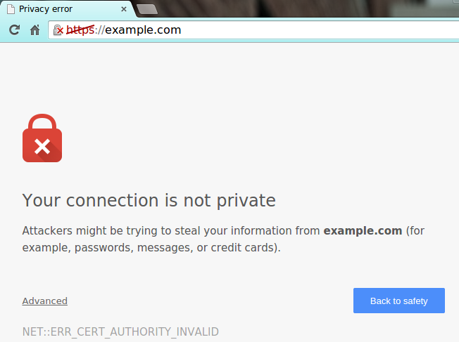
3. Web Browser Certificates
If the verification fails you get this warning (on Chrome):

Slide 23
4. Certificates
In early March 2018 certificates issued by Trustico on behalf of Digicert for 23,000 websites were revoked when the CEO of Trustico emailed the private keys matching these certificates to Digicert. Why was such action taken to revoke the certificates?

Slide 24
4. Certificates
In Studio 2 it is stated that your private keys must never, ever leave Vincent’s Pi. This is for security reasons. If anyone holds Vincent’s private key, he can now pretend to be Vincent and attach fraudulent signatures to messages, and of course decrypt secret messages from you to Vincent.
In the March 2018 case the CEO of Trustico somehow managed to get his hands on 23,000 private keys belonging to clients, and email them to Digicert. It is still unknown how Trustico managed to get the keys.

Slide 25
4. Certificates
In any case with these private keys it is now possible for fake websites to pretend to be legitimate websites, because they can now decrypt any TLS message you send out using the public key. These fake websites will work fine on your browser since the private key matches the certificate, and the certificate is signed by a trusted CA, which in this case is Digicert.
Revoking the certificates prevents web browsers from connecting with any server using this private/public key pair, giving you the error message shown above.

Slide 26
Part2
Power Management

Slide 27
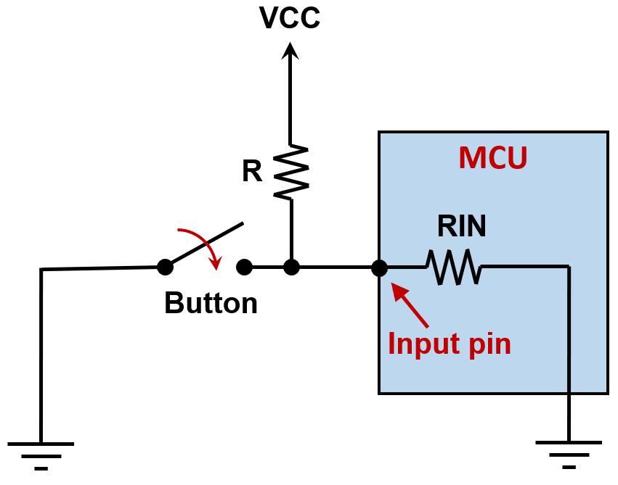
1. Pull-Up Resistors
Pull-up (and also pull-down) resistors are very common when using microcontroller units (MCU). In earlier studios, you have used them together with push buttons to control the logic at input pins.

Slide 28
1. Pull-Up Resistors
Why are they needed?
If nothing is connected to an input pin, its voltage will be floating, and the detected logic can go either high or low.
To prevent this unknown state, we use these resistors to ensure that the pin is either in a high or low state, while using a small amount of current.
In our studios, we always use R = 10 kΩ.

Slide 29
1. Pull-Up Resistors
For a typical MCU input pin, its input resistance RIN needs to be high, and can be between 1 to 100 MΩ.
In this question, we try to understand whether R = 10 kΩ is a good choice.
Assume VCC = 5 V, and RIN = 1 MΩ.

Slide 30
1. Pull-Up Resistors
(a) Can R be 0? Why not?
If R is 0, VCC will be shorted to ground when the switch is closed. The current will be large and can cause damage to VCC source.

Slide 31
1. Pull-Up Resistors
(b) Assuming R = 10 kΩ, what is the voltage at the input pin when the switch is opened, and what is the current drawn from the source VCC?
Current = VCC/(R + RIN) = 5 V / (1.01 MΩ) = 4.95 μA. Voltage = RIN/(R+RIN) x VCC = 1/1.01 x 5 V = 4.95 V

Slide 32
1. Pull-Up Resistors
(c) Repeat (b) when the switch is closed.
Current = VCC/R = 5 V / 10 kΩ = 0.5 mA Voltage = 0 V

Slide 33
1. Pull-Up Resistors
(d) Suppose someone thinks that the current calculated in (c) is still too high, and decides to save power by using R = 1 MΩ. what is the voltage at the input pin when the switch is open?
Voltage = RIN/(R+RIN) x VCC = 1/2 x 5 V = 2.5 V (may not be detected as a logic high anymore)

Slide 34
2. Voltage Reference
Suppose you are working on an intelligent system that requires the use of a reference voltage for decision making. One possibility is to use a potential divider to obtain this reference voltage. Also suppose that low-power consumption is an important consideration in your design.

Slide 35
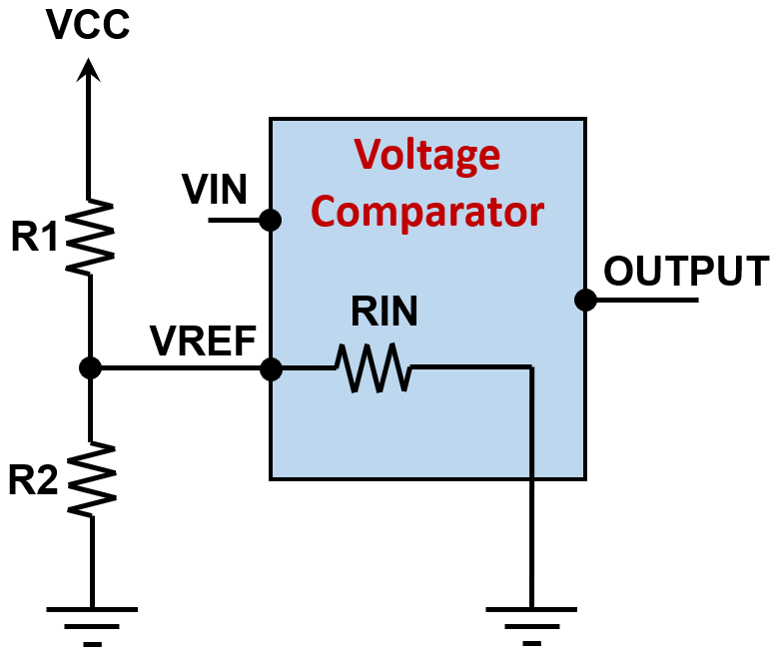
2. Voltage Reference
If VCC = 5V, the required VREF is 2.5 V, and the input resistance RIN of the voltage comparator is 1 MΩ, assess the suitability of each of the following choices of R1 and R2:
R1 = R2 = 100 Ω
R1 = R2 = 10 kΩ
R1 = R2 = 1 MΩ
R1 = R2 = 10 MΩ

Slide 36
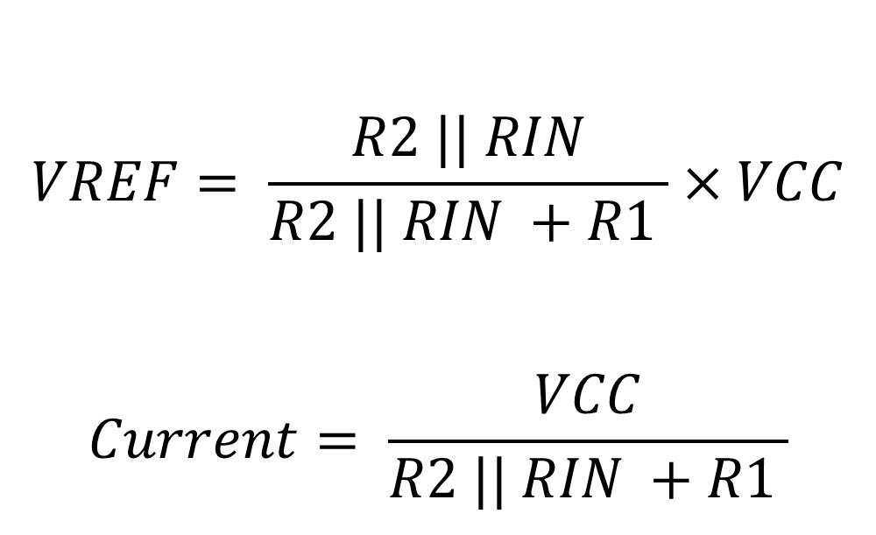
2. Voltage Reference
$$VREF= \frac{R2 || RIN}{R2 || RIN +R1 }×VCC$$
$$Current= \frac{VCC}{R2 || RIN +R1 }$$

Slide 37
2. Voltage Reference
 | R1 | R2 | VREF | Current drawn from VCC | Comments
(a) | 100 Ω | 100 Ω | 2.4999 V | 25 mA | Meets VREF well, but high power wastage
(b) | 10 kΩ | 10 kΩ | 2.4876 V | 0.25 mA | Meets VREF reasonably well (< 1% deviation), and power consumption is reasonably well
(c) | 1 MΩ | 1 MΩ | 1.6667 V | 3.33 μA | Low power consumption, but VREF too far off
(d) | 10 MΩ | 10 MΩ | 0.4167 V | 0.46 μA | Low power consumption, but VREF too far off

Slide 38
2. Voltage Reference
You need to know what you are doing when choosing component values. Always be aware of the different constraints surrounding a problem. As a good engineer, you need to evaluate the design trade-offs and come up with a balanced solution.

Slide 39
Summary
Secure Networking is an important part of ensuring that the system is secure and reliable.
HW choices play an important part in our overall design. We need to be mindful of the decisions we make.

